Slide 1
Mediation and Moderation (Part 3)
3/23/2025

Slide 2
Serial Mediation
Rejects the assumption that mediators are independent—instead, it models potentially causal mechanisms between mediators
X first influences M₁, which then affects M₂, and so on, ultimately influencing Y
The goal is to examine both direct and indirect effects while modeling a stepwise causal process
Example: suppose we are interested in the mediation effect of school bonding (school attachment, connectedness, and academic achievement) on the association between child abuse and adult violence perpetration
Parallel (?)
In a parallel model, school attachment (M₁), school connection (M₂), and academic achievement (M₃) would be assumed to independently mediate the effect of child maltreatment (X) on violence perpetration (Y)
Serial (?)
In a serial model, child maltreatment first reduces school attachment (M₁), which then lowers academic achievement (M₂), ultimately influencing bad outcomes (Y)

Slide 3
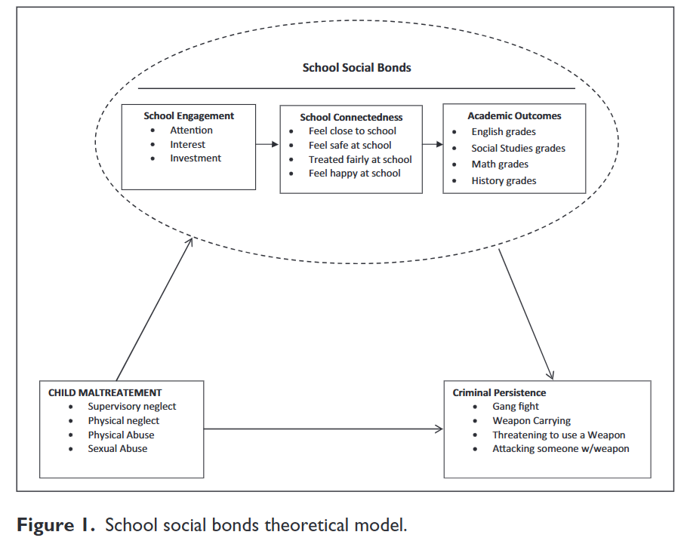
Child Maltreatment, School Bonds, and Adult Violence: A Serial Mediation Model
Hypothesis 1: Physically abused children who engage in violence as youth (vs. those not physically abused but who engaged in violence as youths) will have lower levels of school connectedness, engagement, and achievement, and will be more likely to persist in violent behavior as adults (i.e., there will be a direct effect between CPA and persistence in adult violence).
Hypothesis 2: School characteristics will both independently, jointly, and serially (i.e., as a sequence) mediate the relationship between CPA and persistence in adult violence (i.e., school social bonds will indirectly affect the relationship between CPA and adult violence perpetration).
Hypothesis 3: Sex of child will moderate the mediation effect of school characteristics on the relationship between CPA and adult violence perpetration

Slide 4
Serial and Parallel Mediation: Similarities
In both serial and parallel mediation, the total effect of X on Y is partitioned into direct and indirect effects. The idea is that the effect of X on Y can be split into two parts:
Direct effect: the part of X’s influence on Y that does NOT operate through the mediators (c’)
Indirect effect(s): the part of X’s influence that passes through one or more mediators
This means that part of X’s influence on Y occurs directly, while part occurs indirectly through mediators
Regression weights in both models represent the strength of relationships between variables at each step of the mediation pathway
These coefficients estimate the expected difference in Y for a one-unit change in X, as it propagates through the mediators
In mediation, we multiply these coefficients along a path to get the indirect effect through that path

Slide 5
Serial and Parallel Mediation: Differences
Mediators influence each other in a causal sequence—X affects M₁, which then affects M₂, ultimately influencing Y
The order of mediators matters, as each mediator transmits the effect of the previous step
Note: in PROCESS place variables in the order in which you hypothesize your variables will be related
The total indirect effect is still the sum of individual pathways, but the paths include chains of effects (e.g., X → M₁ → M₂ → Y)
Parallel mediation is model 4 in PROCESS, serial mediation is model 6

Slide 6
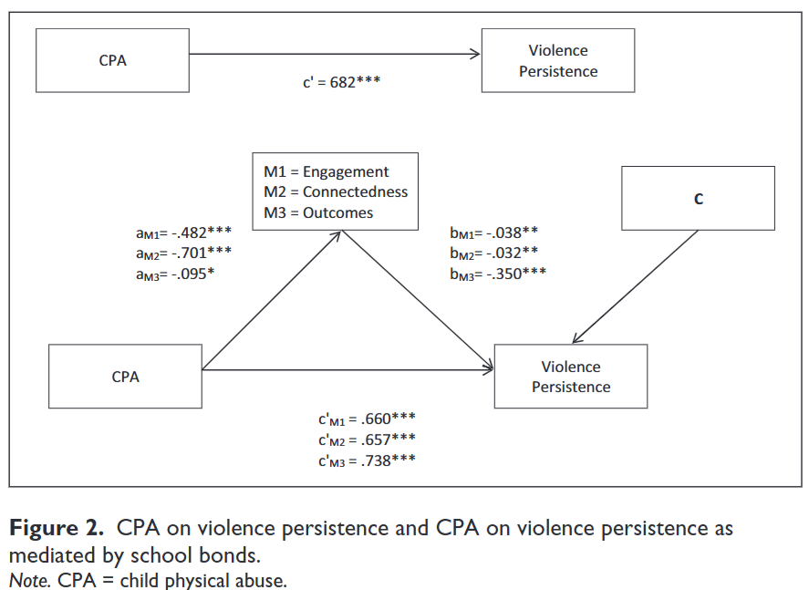
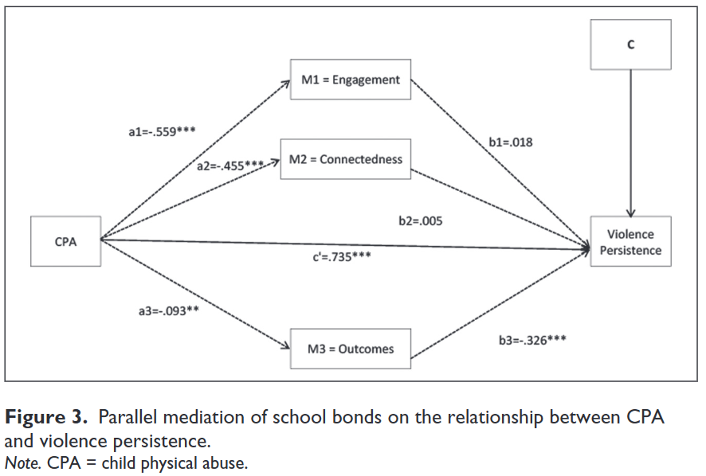
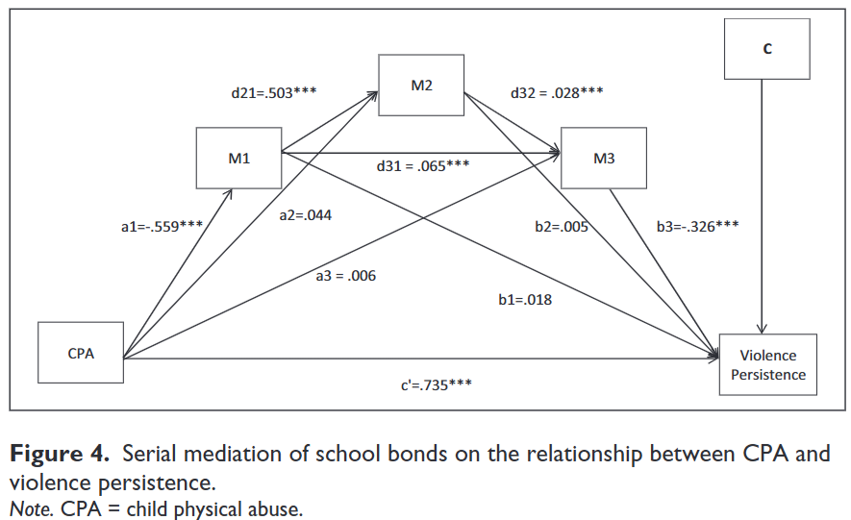
Simple Mediation v Serial Mediation

Slide 7
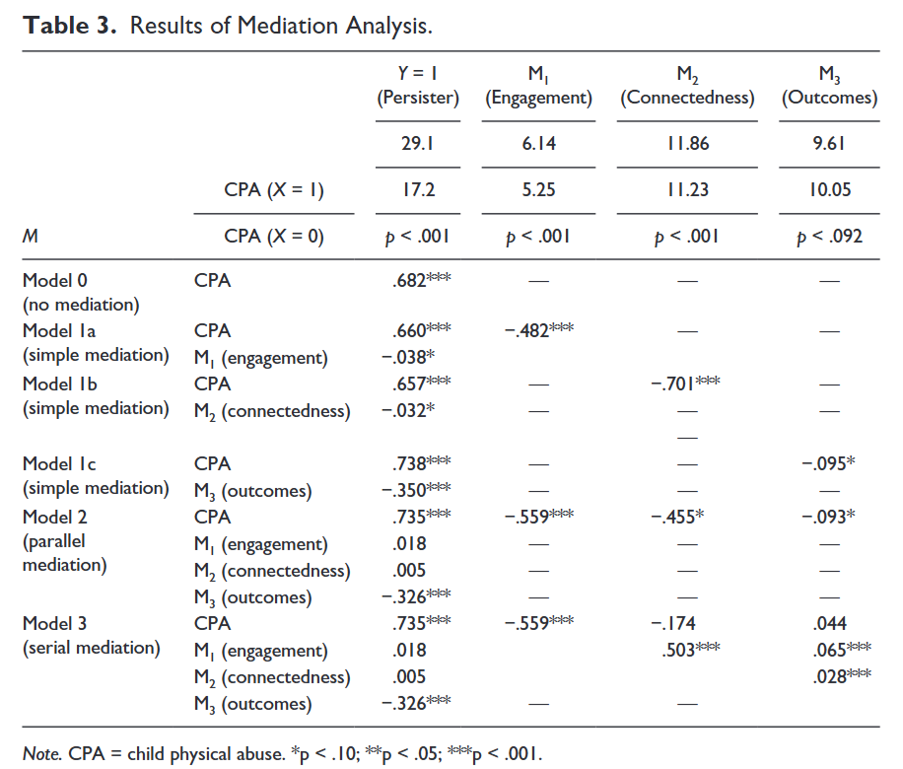
Only two of the seven indirect effects contain CIs lying entirely above zero.
More specifically, we found that physically abused children are less likely to be engaged at school, which is, in turn, associated with poorer grades and a higher propensity to engage in adult violent crime (indirect effect = 0.0260, Boot SE = 0.0154, Boot LL CI = 0.0050, Boot UL CI = 0.0701).
The second direct effect included the impact of connectedness, school attachments, and poor academic achievement and was also statistically significant (effect =0.0270, Boot SE = 0.0165, Boot LL CI = 0.0050, Boot UL CI = 0.0751).
Relative to those who are physically abused, non-maltreated children are more academically engaged, thereby increasing their sense of belonging at school, which, in turn, is associated with better academic outcomes and a higher probability of transitioning away from delinquency as an adult

Slide 8
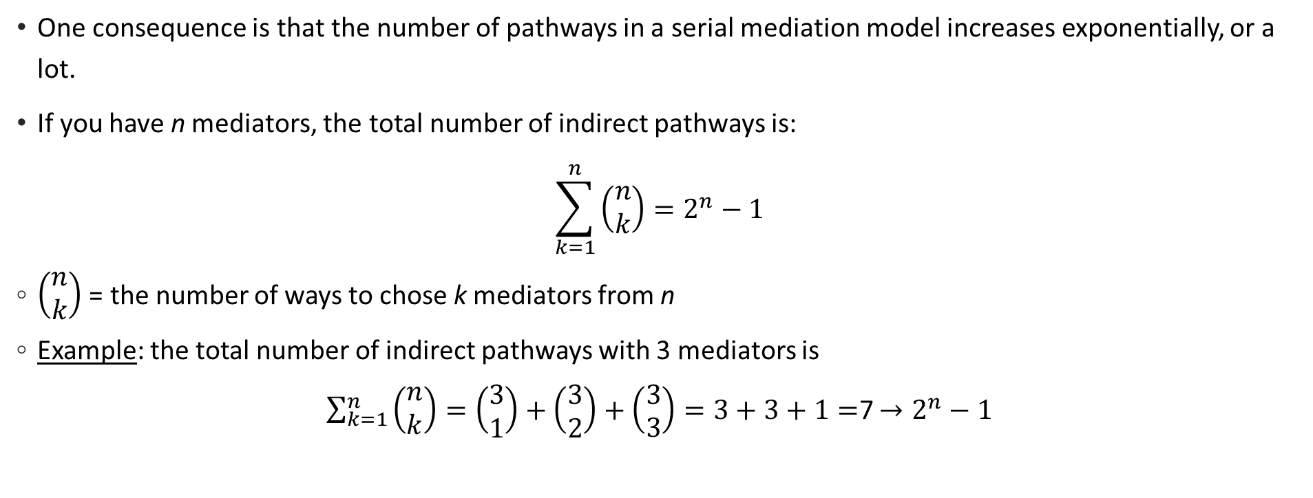
How many pathways?
One consequence is that the number of pathways in a serial mediation model increases exponentially, or a lot.
If you have n mediators, the total number of indirect pathways is:
$$\sum_{k=1}^{n}{\left(\begin{aligned}n \\ k\end{aligned}\right)=2^{n}−1}$$
$\left(\begin{aligned}n \\ k\end{aligned}\right)$ = the number of ways to chose k mediators from n
Example: the total number of indirect pathways with 3 mediators is
$\sum_{k=1}^{n}{\left(\begin{aligned}n \\ k\end{aligned}\right)}=\left(\begin{aligned}3 \\ 1\end{aligned}\right)+\left(\begin{aligned}3 \\ 2\end{aligned}\right)+\left(\begin{aligned}3 \\ 3\end{aligned}\right)=3+3+1=$7 $→2^{n}−1$

Slide 9
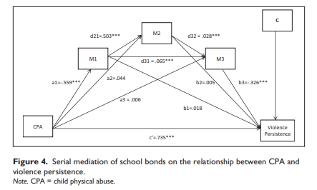
Here are the valid paths:
Length 1:
M₁
M₂
M₃
Length 2 (only forward):
M₁ → M₂
M₁ → M₃
M₂ → M₃
Length 3:
M₁ → M₂ → M₃

Slide 10
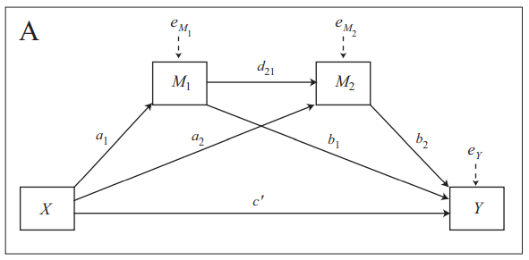

A Two-Mediator Serial Model
3
1
2
X affects Y through four pathways: three indirect pathways (1, 2, 3) and a direct pathway (4)
With three mediators the model becomes complex quickly
4
$$M_{1}=i_{M_{1}}+a_{1}X+e_{M_{1}}$$
$$M_{2}=i_{M_{2}}+a_{2}X+d_{21}M_{1}+e_{M_{2}}$$
$$Y=i_{Y}+c^{′}X+b_{1}M_{1}+b_{2}M_{2}+e_{Y}$$
What is the serial indirect effect?
Notes:
This statistical model translates into three equations, because the model contains three consequent variables

Slide 11
Two Mediators in Serial
The three specific indirect effects are each estimated as the product of the regression weights linking X to Y through at least one M
The specific indirect effect of X on Y through only M1 is a1b1
The specific indirect effect through M2 only is a2b2
The specific indirect effect through both M1 and M2 in serial is a1d21b2
Total effect = direct effect + total indirect effect (i.e. sum of indirect effects)
$$c=c^{′}+a_{1}b_{1}+a_{2}b_{2}+a_{1}d_{21}a_{2}b_{2}$$

Slide 12
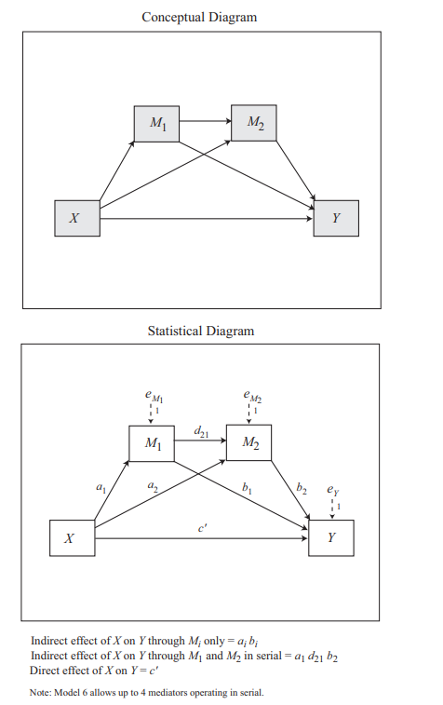
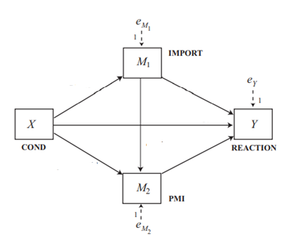
Multiple mediator model of the presumed media influence study
We need to use model 6 to do this analysis
This model can take up to 4 serial mediators
The order you enter the mediators matters, so for M1 → M2 enter M1 first
In our model, Import → PMI so enter Import first

Slide 13

Take the output ONE step at a time!!

Slide 14
Step 1: Does X Affect the First Mediator (IMPORT)?
OUTCOME VARIABLE:
import
Model Summary
R R-sq MSE F df1 df2 p
.1809 .0327 2.9411 4.0942 1.0000 121.0000 .0452
Model
coeff se t p LLCI ULCI
constant 3.9077 .2127 18.3704 .0000 3.4866 4.3288
cond (a1) .6268 .3098 2.0234 .0452 .0135 1.2401

Slide 15
Step 1 Interpretation
The first model looks at whether article placement (cond) influences IMPORT (M1)
X significantly predicts IMPORT (β = 0.6268, p = 0.0452)
This means that people who saw the article on the front page perceived it as more important
The confidence interval (CI) [0.0135, 1.2401] does not contain zero, confirming a significant effect
Interpretation: Seeing the article on the front page increases the perceived importance of the article

Slide 16
Step 2: Does IMPORT (M1) Influence the Second Mediator (PMI)?
OUTCOME VARIABLE:
pmi
Model Summary
R R-sq MSE F df1 df2 p
.3114 .0970 1.6027 6.4428 2.0000 120.0000 .0022
Model
coeff se t p LLCI ULCI
constant 4.6104 .3057 15.0836 .0000 4.0053 5.2156
Cond (a2) .3536 .2325 1.5207 .1310 -.1068 .8139
import (d21) .1961 .0671 2.9228 .0041 .0633 .3290

Slide 17
Step 2 Interpretation
Now, we test whether IMPORT influences PMI.
IMPORT significantly predicts PMI (β = 0.1961, p = 0.0041).
X (cond) does not directly predict PMI (β = 0.3536, p = 0.1310), meaning article placement alone doesn’t significantly change perceived media influence unless IMPORT is considered.
CI for IMPORT’s effect on PMI [0.0633, 0.3290] does not include zero, confirming a significant effect.
Interpretation: When people perceive an article as more important, they are more likely to believe the media is influencing public opinion.

Slide 18
Step 3: Do IMPORT and PMI Predict Purchase Intention (Reaction)?
OUTCOME VARIABLE:
reaction
Model Summary
R R-sq MSE F df1 df2 p
.5702 .3251 1.6628 19.1118 3.0000 119.0000 .0000
Model
coeff se t p LLCI ULCI
constant -.1498 .5298 -.2828 .7778 -1.1989 .8993
cond (c’) .1034 .2391 .4324 .6662 -.3701 .5768
Import(b1) .3244 .0707 4.5857 .0000 .1843 .4645
pmi (b2) .3965 .0930 4.2645 .0000 .2124 .5806
Notes:
The direct effect of the manipulation in this serial multiple mediator model is exactly the same as in the parallel multiple mediator model because whether the mediators are modeled as causally influencing each other or not does not change the model of Y
Location of the article in the newspaper continues to be unrelated to intentions to buy sugar independent of the effect of perceived importance and presumed media influence

Slide 19
Step 3 Interpretation
Now, we check whether IMPORT and PMI influence reaction (purchase intention, Y)
IMPORT significantly predicts purchase intention (β = 0.3244, p < .001)
PMI significantly predicts purchase intention (β = 0.3965, p < .001)
X (cond) does not significantly predict purchase intention directly (β = 0.1034, p = 0.6662).
CI for IMPORT’s effect on reaction [0.1843, 0.4645] and PMI’s effect on reaction [0.2124, 0.5806] do not include zero, confirming significant effects
Interpretation: The more important people perceive the article, and the more they believe media influences public opinion, the stronger their intention to buy sugar

Slide 20
Step 4: Direct vs. Indirect Effects
Indirect effect(s) of X on Y:
Effect BootSE BootLLCI BootULCI
TOTAL .3923 .1672 .0835 .7329
Ind1 (a1b1) .2033 .1157 .0002 .4531
Ind2 (a2b2) .1402 .1017 -.0496 .3502
Ind3 (a1d21b2) .0488 .0357 -.0004 .1371
Indirect effect key:
Ind1 cond -> import -> reaction (specific ind. effect of article location on reactions via importance)
Ind2 cond -> pmi -> reaction
Ind3 cond -> import -> pmi -> reaction (this is the only thing that is NEW)
Interpretation of ind3: Relative to those assigned to the interior page condition, those told the article would appear in the front page (cond) perceived the sugar shortage as more important (import) which in turn was associated with a greater perception that others would be influenced by the article (pmi) which led to a greater intention to buy sugar (reaction)
Note: must look to the pattern of coefficients in the model (i.e., positive or negative)

Slide 21
Step 4: Interpretation (for clarity)
The direct effect of X on Y (purchase intention) is not significant (β = 0.1034, p = 0.6662), meaning the article's placement does not directly influence purchase intention.
However, the total indirect effect is significant (β = 0.3923, CI [0.0836, 0.7352]), meaning mediation is occurring.
Indirect Path | Effect | SE | 95% CI | Interpretation
Ind1: X → IMPORT → Y | 0.2033 | 0.1165 | [0.0048, 0.4656] | Front-page placement increases IMPORT, which increases purchase intention.
Ind2: X → PMI → Y | 0.1402 | 0.1028 | [-0.0459, 0.3656] | Not significant—front-page placement does not significantly influence PMI, which then affects Y.
Ind3: X → IMPORT → PMI → Y | 0.0488 | 0.0348 | [-0.0006, 0.1340] | Borderline significance—front-page placement increases IMPORT, which increases PMI, leading to higher purchase intention.
IMPORT alone is the strongest mediator (Ind1 is significant).
PMI alone is not a strong mediator (Ind2 is not significant).
The serial mediation path (Ind3: X → IMPORT → PMI → Y) is weak but has borderline significance

Slide 22
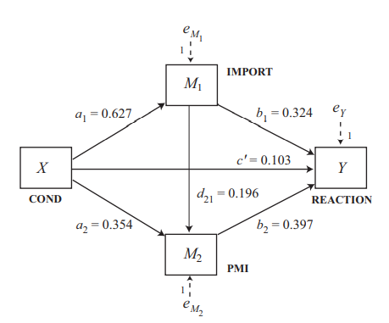



Statistical Model
Open the dataset pmi.sav and run the serial
mediation model
$$\hat{M_{1}}=3.908+0.627X$$
$\hat{M_{2}}=4.61+0.354X+0.$196$M_{1}$
$\hat{Y}$=-.150+.103X+.324$M_{1}+.397M_{2}$

Slide 23
Bonus: Contrasts in specific indirect effects
Defined: a contrast in specific indirect effects refers to the comparison between two or more distinct pathways through which an independent variable (X) influences a dependent variable (Y) via multiple mediators (e.g., M₁, M₂, etc.) arranged in a sequential order
We may want to compare the size or significance of individual indirect pathways
Example:
The indirect effect through M1 only is significantly different from the effect through M1 and M2 in sequence
The indirect effect through M1 → M2 is stronger or weaker than the effect through M1 alone
Is the path CPA → CONNECT → PERSIST stronger than CPA → CONNECT → OUTCOME → PERSIST ?
X → M1 → M2 → Y
X affects M1, which in turn affects M2, which finally affects Y
X → M1 → Y
X → M2 → Y
X → M1 → M2 → Y ← the full serial path

Slide 24
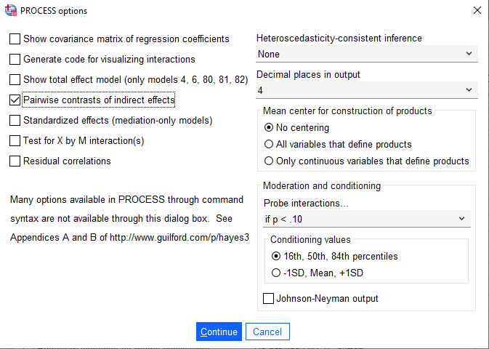
Are the indirect effects significantly different from each other?
Contrasts calculates all possible pairwise comparisons between specific indirect effects
These comparisons are found in the PROCESS output in the rows labeled “(C1),” “(C2),” etc.

Slide 25
Step 5: Contrasts of Indirect Effects
Indirect effect(s) of X on Y:
Effect BootSE BootLLCI BootULCI
TOTAL .3923 .1664 .0788 .7306
Ind1 .2033 .1168 .0009 .4541
Ind2 .1402 .0997 -.0405 .3547
Ind3 .0488 .0360 -.0005 .1365
(C1) .0631 .1583 -.2311 .3897
(C2) .1546 .1008 -.0036 .3830
(C3) .0915 .1082 -.1210 .3142
Specific indirect effect contrast definition(s):
(C1) Ind1 minus Ind2
(C2) Ind1 minus Ind3
(C3) Ind2 minus Ind3
C1 = a1b1 − a2b2 = 0.203 − 0.140 = 0.063
C2 = a1b1 − a1d21b2 = 0.203 − 0.049 = 0.155
C3 = a2b2 − a1d21b2 = 0.140 − 0.049 = 0.091
Notes:
The interpretation is that no specific indirect effect is statistically different than any other specific indirect effect.

Slide 26
Step 5: Indirect Effect Contrasts
Contrast tests compare the strength of different mediation pathways.
Contrast | Definition | Effect | SE | 95% CI | Interpretation
C1: Ind1 - Ind2 | IMPORT vs. PMI | 0.0631 | 0.1612 | [-0.2441, 0.3882] | No significant difference between IMPORT and PMI’s mediation effects.
C2: Ind1 - Ind3 | IMPORT vs. IMPORT → PMI | 0.1546 | 0.1003 | [-0.0036, 0.3859] | No significant difference between IMPORT alone vs. IMPORT + PMI pathway.
C3: Ind2 - Ind3 | PMI vs. IMPORT → PMI | 0.0915 | 0.1103 | [-0.1234, 0.3224] | No significant difference between PMI alone vs. IMPORT → PMI pathway.
None of these contrasts are statistically significant, meaning no one mediation path is significantly stronger than the others.

Slide 27
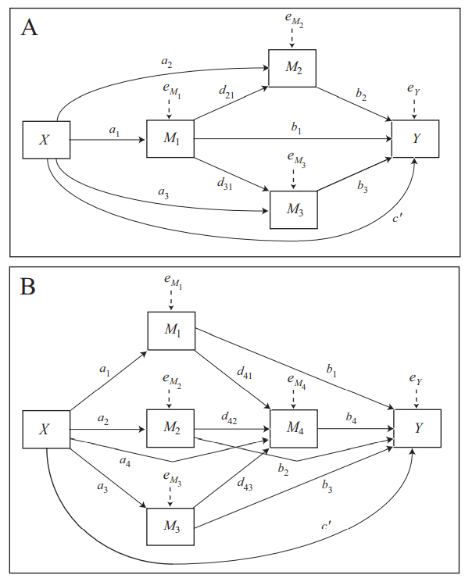
Combining Models
This model includes both parallel and serial mediators (so cool!)
You cannot do many variations of this model using process but you can estimate this model (?)
This is model 81
Look through the dozens of models in the back of the book

Slide 28
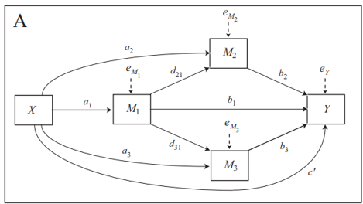
Context: Investigating how exposure to community violence (X) affects youth depressive symptoms (Y), mediated by psychological and social factors.
Variables:
X = Exposure to community violence
M₁ = Post-traumatic stress symptoms
M₂ = School connectedness
M₃ = Peer support
Y = Depressive symptoms
Interpretation of Pathways:
a₁, a₂, a₃: Direct effects of exposure on each mediator
d₂₁, d₃₁: PTSD symptoms influence school connectedness and peer support
b₁, b₂, b₃: Each mediator’s effect on depressive symptoms
c′: Direct effect of exposure on depression, after accounting for mediators
Do you understand?
What is the specific indirect effect of PTSS (M1) on the association between exposure to CV and depressive symptoms?
What is the specific indirect effect of school connectedness (M2) on the effect of PTSS on depressive symptoms
What is the total indirect effect of M1?
This model allows testing whether PTSD symptoms act as a primary response to violence exposure, and whether they indirectly influence depressive symptoms through weakened school and peer relationships. It also assesses whether school connectedness and peer support are independent mechanisms against depression. Social workers could use this to design multi-pronged interventions focused on trauma-informed treatment and prosocial peer support.
Notes:
The extent to which VEX affects depression through its impact on PTSS.
The extent to which PTSS affects depression through its impact on school connectedness.

Slide 29
The total indirect effect of M₁ (PTSS) on depressive symptoms (Y) in Model A includes all mediated pathways that start at M₁ and end at Y, whether direct or via other mediators
Path | Description | Expression
X → M₁ → Y | Specific indirect effect via M₁ | a₁ · b₁
X → M₁ → M₂ → Y | Specific indirect via M₁ and M₂ | a₁ · d₂₁ · b₂
X → M₁ → M₃ → Y | Specific indirect via M₁ and M₃ | a₁ · d₃₁ · b₃
— | Total indirect via M₁ | a₁ · b₁ + a₁ · d₂₁ · b₂ + a₁ · d₃₁ · b₃

Slide 30
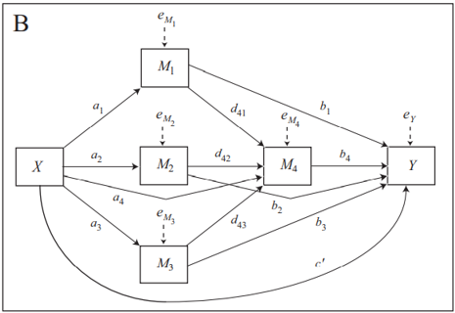
Context: your turn

Slide 31
Before we continue to moderation, we are going to look at a real example from my RM class examining the serial
mediation of stressors during pregnancy, substance misuse, and poor health outcomes on the association between
experiencing IPV during pregnancy and poor birth outcomes (i.e., low birth weight).
Then we are going to assess your knowledge of mediation.

Slide 32
Research objectives:
To assess the direct relationship between intimate partner violence (IPV) before pregnancy and low birth weight (LBW);
To examine whether stress-related factors during pregnancy (e.g., financial strain, social instability), of first-trimester substance misuse, and poor health outcomes mediate the relationship between IPV and LBW in serial.

Slide 33
Background: Women who experience intimate partner violence (IPV) in the 12 months before pregnancy are at increased risk of adverse birth outcomes. The literature examining the relationship between IPV and low birth weight (LBW) has focused narrowly on direct associations rather than a broader view exploring the underlying pathways linking IPV to birth outcomes. The present study applies the biopsychosocial model to examine (a) the direct association between IPV and LBW and (b) the indirect association conceptualized as heightened stress during pregnancy—such as financial strain (e.g., problems paying rent or mortgage) and social instability (e.g., divorce or separation, moving to a new address, homelessness)—leads to first-trimester substance misuse, which in turn contributes to poor health outcomes (e.g., high blood pressure), ultimately increasing the risk of LBW.
Methods: Using data from the Pregnancy Risk Assessment Monitoring System (PRAMS) Analytic Research File (ARF) from 2016 to 2022, we conducted a serial mediation analysis using the PROCESS macro in R to evaluate these hypothesized relationships.

Slide 34
Results: Consistent with previous research, results indicate that women who experience IPV before pregnancy have a higher likelihood of delivering a low-birth-weight infant. Results showed that the association is totally mediated by the effects of stress during pregnancy, early substance misuse, and deteriorating maternal health. We further found that the relationship between IPV and LBW operates through an accumulating pathway in which IPV-related stress increases substance use in the first trimester, contributing to poor maternal health and adverse birth outcomes.
Conclusions: These findings underscore the importance of early intervention efforts to address IPV-related stress and substance use in pregnancy to improve maternal and infant health outcomes. However, it is important to note that Ohio is excluded from PRAMS data for these years, which limits the ability to capture trends in the state. This highlights a critical policy gap—Ohio must expand its inclusion in PRAMS to better protect vulnerable pregnant individuals, particularly those exposed to abuse, through early intervention and comprehensive health surveillance to improve maternal and infant health outcomes.

Slide 35
Table. Impact of IPV on LBW (PRAMS study)
 | Beta | SE | Standardized Beta | t | p-value
(Constant) | 3122.878 | 1.584 |  | 1971.194 | 0.000
IPV | -117.4690 | 8.743 | -0.029 | -13.435 | 0.000
Dep. Var. LBW
Women and other pregnant persons who experience abuse prior to their pregnancy have babies that
are about one-quarter of a pound (i.e., 117.47 grams) smaller, on average, compared to those who do
not experience abuse.
Let’s examine the potential pathways by which these effects may take place. Open fullprams.sav

Slide 36

Effect Moderation

Slide 37
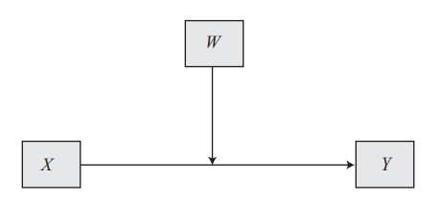
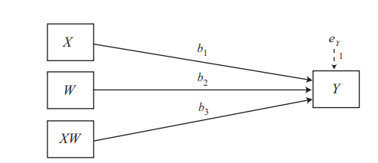

Simple Moderation
Hypothesis?
SEXMIN
(Yes/No)
PTSS
DELINQ
Number of Symptoms
Number of Events
$Y=i_{Y}+b_{1}X$+ $b_{2}W$+ $b_{3}XW+e_{Y}$
$DELINQ=i_{Y}+b_{1}PTSS$+ $b_{2}SEXMIN$+ $b_{3}PTSS∗SEXMIN+e_{Y}$
Notes:
The effect of PTSS on DELINQ is greater for SEXMIN compared to non-SEXMIN

Slide 38
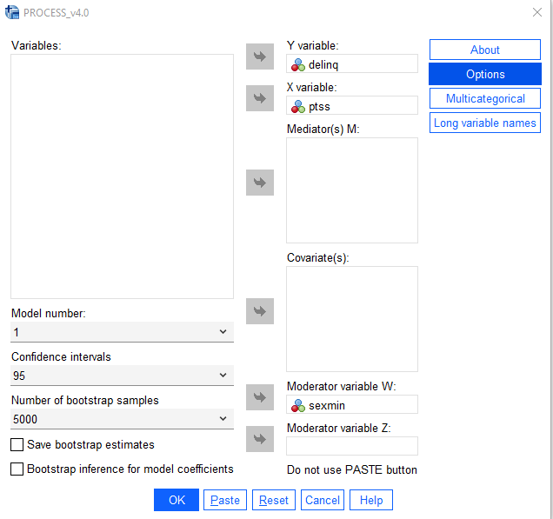
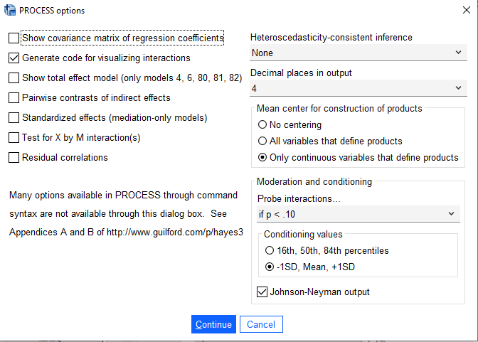
Example 7: Simple Moderation
Open sexmin_pts_delinq.sav

Slide 39
Moderation Results
Product terms key:
Int_1 : ptss x sexmin
OUTCOME VARIABLE:
delinq
Model Summary
R R-sq MSE F df1 df2 p
.3750 .1406 6.3057 6.5985 3.0000 121.0000 .0004
Model
coeff se t p LLCI ULCI
constant 1.7075 .2633 6.4837 .0000 1.1861 2.2288
ptss -.0450 .0617 -.7291 .4673 -.1671 .0771
sexmin 1.7454 .5290 3.2991 .0013 .6980 2.7927
Int_1 .2579 .1246 2.0707 .0405 .0113 .5046
Let’s write out the equations for SEXMIN = 1 and SEXMIN = 0
Notes:
The effect of PTS on delinquency depends on sexual minority status
1.7075 - .0450ptss + 1.7454 + .2579ptss

Slide 40
$$delinq= β_{0}+β_{1}PTSS+β_{2}SEXMIN=β_{3}(PTSS x SEXMIN)$$
Term | Coefficient
Intercept | 1.7075
PTSS | –0.0450
Sex Minority | 1.7454
Interaction (PTSS × sexmin) | 0.2579
For sexmin = 0 (not a sexual minority):
delinq = 1.707 – 0.045 x PTSS
For sexmin = 1 (A sexual minority):
delinq = 1.707 – 0.045 X PTSS + 1.7454 + 0.2579 X PTSS
(re-arrange): delinq = (1.7075 + 1.7454) + (−0.0450+0.2579) x PTSS
Delinq = 3.4529 + 0.2129 X PTSS

Slide 41
For a PTSS score of 12 what is delinquency for sexual minorities and persons who are not sexual minorities?
For sexmin = 0 (not a sexual minority):
delinq = 1.707 – 0.045 X 12 = 1.1675
For sexmin = 1 (A sexual minority):
delinq = 3.4529 + 0.2129 X 12 = 6.0077
This clearly demonstrates the interaction effect
We are interested in whether the effect of PTSS on delinquency is different
conditional on one’s status as a sexual minority.
For non-sexual minorities, PTSS has a flat effect (i.e., slope = -.045)
For sexual minorities, PTSS has a strong positive effect (i.e., .02129)

Slide 42
The effect of PTSS on DELINQ for HETEROSEXUAL YOUTH (NOT SEXMIN)
Conditional effects of the focal predictor at values of the moderator(s):
sexmin Effect se t p LLCI ULCI
.0000 -.0450 .0617 -.7291 .4673 -.1671 .0771
1.0000 .2130 .1082 1.9677 .0514 -.0013 .4273
This table gives the conditional effect of X on Y at values of the moderator
So, here the effect is the effect of PTS on DELINQ for different sexual minority statuses
The effect is negative for strictly heterosexual youth and positive for sexmin
The result for sexmin=1 is significant
The effect of PTSS on DELINQ for HETEROSEXUAL YOUTH (NOT SEXMIN)

Slide 43
Data to graph
Plotting effects moderation.xlsx
Data for visualizing the conditional effect of the focal predictor:
Paste text below into a SPSS syntax window and execute to produce plot.
DATA LIST FREE/
ptss sexmin delinq .
BEGIN DATA.
-5.4000 .0000 1.9503
.4400 .0000 1.6877
5.4400 .0000 1.4629
-5.4000 1.0000 2.3027
.4400 1.0000 3.5466
5.4400 1.0000 4.6115
END DATA.
GRAPH/SCATTERPLOT=
ptss WITH delinq BY sexmin .

Slide 44
The Johnson-Neyman (J-N) Regions of Significance
The Johnson-Neyman (J-N) technique is a method used in moderation analysis to determine the specific values of a moderator variable at which the effect of a predictor on an outcome becomes statistically significant
You use the Johnson-Neyman approach when you are interested in the following question: at what values of W (the moderator) does X significantly affect Y?
Instead of testing the simple slopes of X on Y at arbitrary levels of the moderator (e.g., mean, ±1 SD), the J-N technique identifies the range of values of the moderator where
The effect of X on Y is significant (p < .05); and
The effect of X on Y is not significant (p > .05)
This provides a continuous region of significance rather than discrete points

Slide 45
Example
Suppose you are examining how PTSS moderates the effect of SEXMIN status on delinquent behavior and the interaction term is significant (woop woop)
Again, this means that the impact of being a sexual minority on delinquent behavior is different as the number of PTSS symptoms increases (?)
From within PROCESS (by Andrew Hayes), select Johnson-Neyman and it will tell you
The effect of sexual minority status is significant only when PTSS is below a certain value but when PTSS is above a certain value PTSS is no longer significant
In R, J-N is visualized as a line of the conditional effect of X on Y across ranges of W (the moderator)
Note: if there is more than one moderator, then it’s given a label of Z
Vertical lines are shaded regions showing where the effect is significant (or not)
Confusingly, the shaded region represents the range of values of the moderator (i.e., W or Z) where the effect of X on Y is NOT significant
Note: look at the legend in R to make sense of it

Slide 46
Using Process in R
Play with https://cardiomoon.shinyapps.io/processR/
Look through PROCESS models
Example: Run a parallel mediation model to test whether depression at time 3 is the mechanism by which traumatic stress (at time 1) is associated with delinquent behavior (time 4) using the ptx vex mod mediation.sav data
Example: Run a serial mediation model to test whether depression at time 3 AND 4 is the mechanism by which traumatic stress (at time 1) is associated with delinquent behavior (time 4) using the ptx vex mod mediation.sav data
Hint: look for the appropriate model in the process template Modelos.pdf
Example: Using the same data, run a moderation model that tests whether younger children who have higher levels of PTSS will have higher levels of delinquent behavior compared to ???

Slide 47
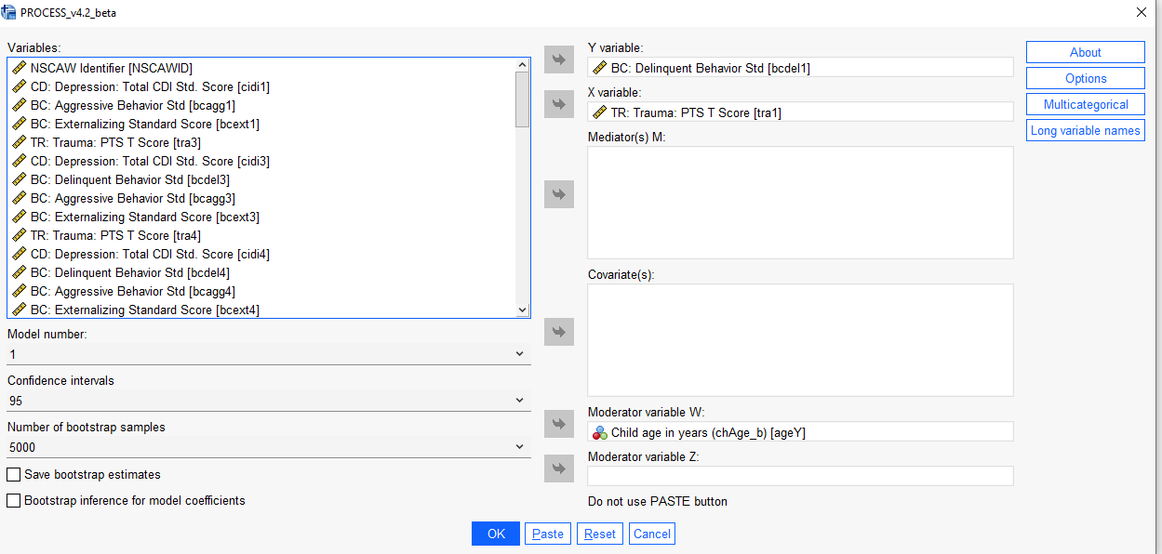

Slide 48
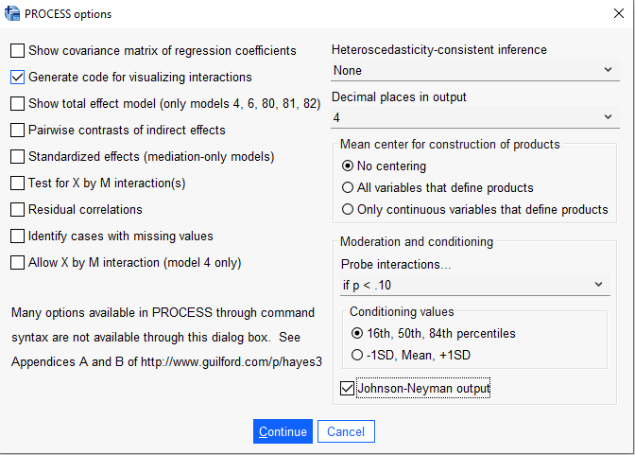

Slide 49
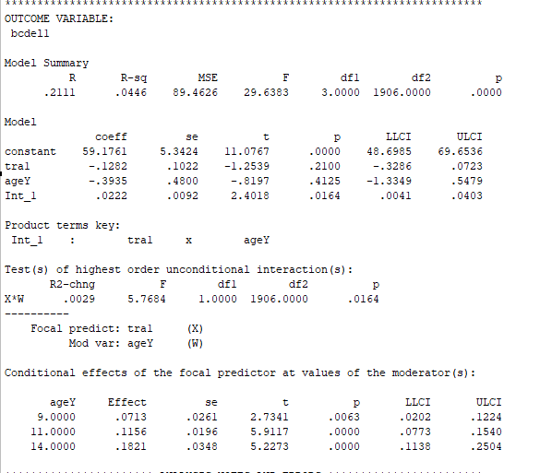

Slide 50
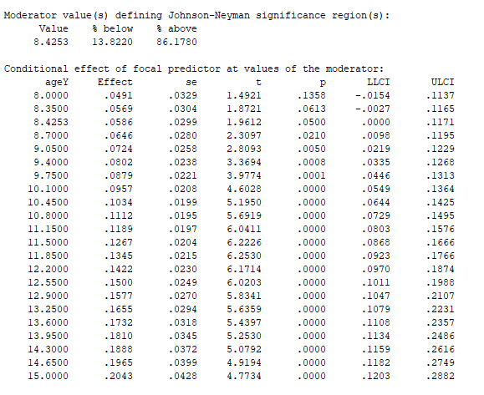
The Johnson-Neyman Technique
The J-N technique is a powerful approach to visualizing regions of significance
The J-N gives the value for which the moderation is significant
Here that value is 8.43, meaning that all values above that are significant moderators above that value
This also means that 86.18% of the ages fall above the age at which the moderator is significant

Slide 51
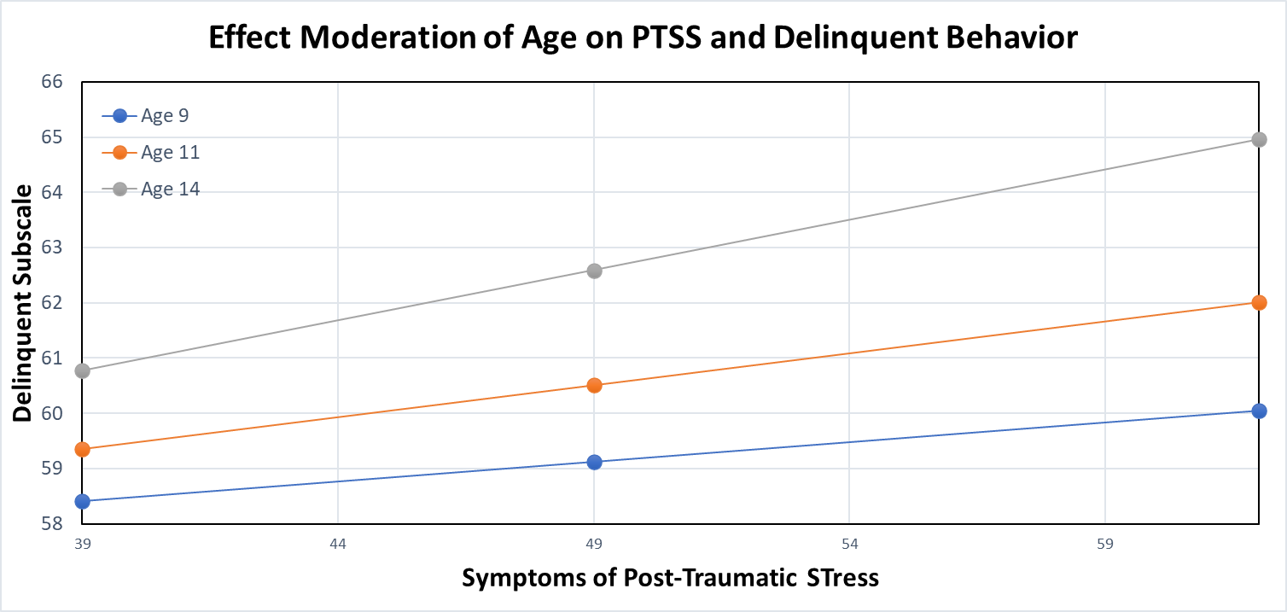
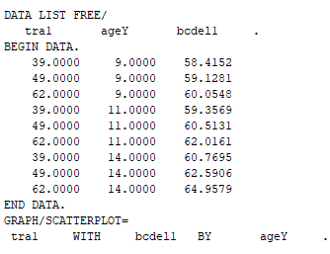
age | tra | delin
9 | 39 | 58.4152
9 | 49 | 59.1281
9 | 62 | 60.0548
11 | 39 | 59.3569
11 | 49 | 60.5131
11 | 62 | 62.0161
14 | 39 | 60.7695
14 | 49 | 62.5906
14 | 62 | 64.9579

Slide 52
Question: why is it likely to NOT find moderation is significant?
Let’s look at how to implement moderation in R

